Slide 1

Generating Sound
with VHDL
Land Boards, LLC

Slide 2
Goal
Make sound out of an FPGA using VHDL
Expect this to be a series with multiple parts

Slide 3
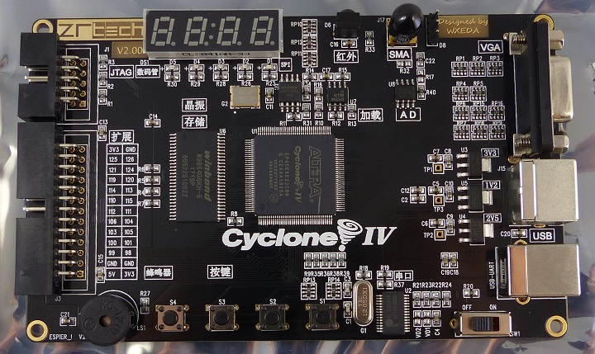
Running on Hardware
Unmod. commercial FPGA card
FPGA : Cypress EP4CE6E22C8N
Card has an on-board piezo buzzer (speaker)
Running
6502 CPU
19K SRAM
VGA, PS/2, USB Serial
OSI SuperBoard II BASIC
FPGA logic is ½ full
FPGA - no SRAM space left

Slide 4
Development Environment
Coding VHDL in VHDL
Altera Quartus II
I am a novice VHDL programmer (20 years ago I was low intermediate level VHDL hack)
Software examples should run on any BASIC but the card is running the OSI SuperBoard II dialect
6502/6809 use PEEK and POKE to access I/O
Z80 BASIC uses INP and OUT to access I/O
Some utilities in Python (format converters)
LibreOffice or EXCEL to make tables

Slide 5
Setting Expectations
Expect this video series to start off way too simple
Expect creeping elegance (Wikipedia)
In software development, creeping elegance, related to creeping featurism and second-system effect, is the tendency of programmers to disproportionately emphasize elegance in software at the expense of other requirements such as functionality, shipping schedule, and usability.
I will make stupid mistakes

Slide 6
Part One - Produce Sound on the Buzzer
FPGA is clocked at 50 MHz
Way too high for sound
Make a counter to create lower frequency
16-bit counter
MSB = 50,000,000 / 2^16 = 762.93 Hz
In the audio range
Counting through all of the bits results in a symmetric waveform since there’s a full count

Slide 7
Block Diagram
16-bit
Up
Counter
MSB
762 Hz
Sound Out
to Buzzer
CLK50
50 MHz
Clock
Notes:
<number>

Slide 8
Counter16 VHDL Code
entity Counter16Bit is
port(
clock: in std_logic; -- 50 MHz clock
Q: out std_logic -- Most Signif Bit of counter
);
end Counter16Bit;
architecture behv of Counter16Bit is
signal Pre_Q: std_logic_vector(15 downto 0);
begin
process(clock, Pre_Q
begin
if rising_edge(clock) then
Pre_Q <= Pre_Q + 1;
end if;
end process;
Q <= Pre_Q(15); -- MSB of counter goes out
end behv;

Slide 9
Code: Counter16Bit.vhd at:
https://github.com/douggilliland/MultiComp/tree/master/MultiComp%20(VHDL%20Template)/Components/SoundGen

Slide 10
VHDL Changes to Microprocessor
Add Counter16Bit to project
Add BUZZER output to pin list at top of Microprocessor entity
BUZZER : out std_logic;
Assign BUZZER to Pin 85 in the Pin Planner
Create instance of counter in architecture of Microprocessor
buzzCounter: entity work.Counter16Bit
port map(
clock => clk, -- 50 MHz clock
Q => BUZZER -- Goes to buzzer output pin
);

Slide 11
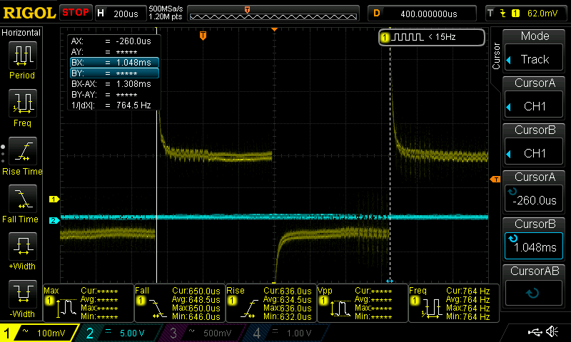
Resulting Waveform
A lot of over/undershoot @ buzzer pin

Slide 12
First Cut Results
Expected 763 Hz
Measured 764 Hz (with cursors)
Limitations
No mute control
Fixed Frequency
Square Wave sounds really annoying

Slide 13
Improvements
Add mute control bit
Use (1) extra bit in the 8 bit register that controls the LEDs
Use D4 bit of register (D0-D3 are LEDs)
Register bit is low at power up
Mute sound when low
Turn on sound with POKE 65492,16 (6502/6809) or OUT 132,16 (Z80)
Turn off sound with POKE 65492,0

Slide 14
VHDL Additions for Muting
Add signal signal buzz : std_logic;
Add control BUZZER <= buzz and latchedBits(4);

Slide 15
Part One - Results
Accurate (got the frequency expected)
Single tone which is can be set to be off/on under program control from BASIC
Uses
Could be used to prompt the user for input or when an error is encountered
Good Start!

Slide 16
Part 2
Review of Part 1
Got 792 Hz sound on the buzzer
Single tone
Quiet volume
Controlled from the 6502 and BASIC
Sufficient for user prompts or error sounds
In Part 2 we build on that minimal design
If you didn’t watch Part 1, it could be helpful since this video assumes Part 1

Slide 17
Improvement
Expand frequencies down lower in audio range
Expand counter up by 2 extra bits
Change counter from 16-bits to 18-bits
Use 3 control register bits as tap selector
Send the three taps to the Counter18
This will allow for selection between 3 tones
Select Q17, Q16, Q15 bits
Expect frequencies of 248, 496, and 792 Hz

Slide 18
Sound Generator w/ Taps
CPU
8 bits
Control
Register
AND-OR
Gates
8
3
Sound Out
to Buzzer
18-bit
Up
Counter
3
CLK50
50 MHz
Clock
Notes:
<number>

Slide 19
Changes to Counter Entity
In Counter18Bit entity
entity Counter18Bit is
port(
clock: in std_logic; -- 50 MHz clock selectTap: in std_logic_vector(2 downto 0); Q: out std_logic -- Most Signif Bit of counter
);
end Counter18Bit;
-- concurrent assignment statement
Q <= ((Pre_Q(15) and selectTap(2)) or – 3:1 mux with individual selects (Pre_Q(16) and selectTap(1)) or (Pre_Q(17) and selectTap(0)));

Slide 20
Changes to Microprocessor Entity
In Microprocessor entity add three tap bits
buzzCounter: entity work.Counter16Bit
port map(
clock => clk,
selectTap => latchedBits(7 downto 5), -- added to select tone
Q => buzz
);

Slide 21
Accessing sounds from BASIC
Use existing Control Register
D0-D3 are LEDs
D4 is enable
D5-D7 are Frequency Tap Selectors
BASIC Commands (from the 6502)
POKE 65492,48 (16 to turn on, 32 for tone)
POKE 65492,80 (16 to turn on, 64 for tone)
POKE 65492,144 (16 to turn on, 128 for tone)
POKE 65492,0 (to turn off)
(Doesn’t need a mute control)

Slide 22
Results
It works!
Limitations
Binary counter every bit is ½ or 2x the previous bit
This is one octave per select bit
Steps very small at low frequencies
Steps very big at higher frequencies
Can accidentally select multiple bits which has strange combinations of sounds
Could do select with two bits and decode

Slide 23
Part 3
Review
Part 1 – Made single sound with mute control from the CPU
Part 2 – Made three different sounds with frequency select from the CPU

Slide 24
Goals of Part 3
Create Middle C note
Middle C is 261.6265 Hz
50,000,000 clks/sec divided-by 261.6265 Hz = 191,112.13 clocks (.13 clocks = close enough)
Next bit up - 2^18 = 262,144
Use the 18-bit counter
Starting count = 262,144 – 191,112 = 72032
0x11578 = 1 0001 0101 0111 1000
Count up to Terminal Count and then reload counter
Use Most Significant Counter bit as sound out

Slide 25
“Middle C” Block Diagram
LOAD
18-bit
Up
Counter
Compar-
ator
All 1’s
TC
Fixed Value
Starting Count
0xx..xx
18
MSB
Sound Out
to Buzzer
CLK50
50 MHz
Clock
Notes:
<number>

Slide 26
Changes to Counter Entity
entity Counter_Middle_C is port( clock: in std_logic; -- 50 MHz clock selectTap: in std_logic_vector(2 downto 0); -- Using 1 bit to mute soundOut: out std_logic -- Most Signif Bit of counter
); end Counter_Middle_C;
architecture behv of Counter_Middle_C is signal Pre_Q: std_logic_vector(17 downto 0); -- 18-bits begin
process(clock, loadVal, Pre_Q) begin if rising_edge(clock) then if Pre_Q = "111111111111111111" then Pre_Q <= "010001010101111000"; -- Starting over count else Pre_Q <= Pre_Q + 1; -- Increment counter end if; end if; end process; -- concurrent assignment statement soundOut <= Pre_Q(17) and selectTap(0); -- Mute control end behv;

Slide 27
Scope Trace for Middle C

Slide 28
Results
It works!
Produced Middle C note
More than accurate enough
Not very loud on tiny buzzer
Buzzer works better at higher frequencies
Behaves like a very small tweeter

Slide 29
Limitations
Using Most Significant Bit as output is asymmetric
MSB symmetry is (131072-74032)/262,144 = 22% low/78% high
Prefer 50%/50% symmetry?

Slide 30
Changes for Symmetry
Get symmetry by putting a Toggle Flip Flop on the Terminal Count
Requires a bit for FF, but one less counter bit
Loses 1 bit of resolution on the count
In the case of Middle C, the LSbit is 0 so there’s no loss of accuracy

Slide 31
“Middle C” Block Diagram
(modified for symmetry)
LOAD
18-bit
Up
Counter
Compar-
ator
All 1’s
TC
Fixed Value
Starting Count
0xx..xx
17
Toggle
F-F
Sound Out
to Buzzer
Term
Count
CLK50
50 MHz
Clock
Notes:
<number>

Slide 32
Add Toggle F-F
Add signal
signal toggleBit =: std_logic;
Shorten counter/terminal count by 1 and add toggle bit
if rising_edge(clock) then
if Pre_Q = "11111111111111111" then
Pre_Q <= "01000101010111100"; -- Starting over count
toggleBit = not toggleBit;
else
Pre_Q <= Pre_Q + 1; -- Increment counter
end if;
end if;
-- concurrent assignment statement
soundOut <= toggleBit and selectTap(0);

Slide 33
Results
It works!
Produced Middle C note with symmetry
More or less bits moves up or down a full octave

Slide 34
Part 4
Review
Part 1 – Made single sound with mute control from the CPU
Part 2 – Made three different sounds with frequency select from the CPU
Part 3 – Made symmetric Middle C note

Slide 35
Goal of this part
Build on previous but with a much more ambitious goal
Produce full octave of sounds
Can then play single octave music
Mary had a little lamb

Slide 36
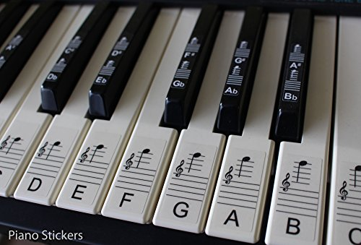
Basic Music Theory
The space between the same keys on a piano is an octave
7 White keys (A-G), 5 black keys (sharps)

Slide 37

More Basic Music Theory
Each octave is 2x the frequency of the lower octave
2x lends itself well to digital manipulation

Slide 38
Make an Octave of music
Need to create 12 frequencies (options)
Could load the pre-load value from the CPU
Three writes to set three parts of the counter pre-load – could be skewed
Alternately, could use a 4-bit register to select between 12 frequencies and do a single write from the CPU to play the note
Better choice

Slide 39
Octave Controller Design
Register control from CPU
Write 4 bit register with the note number
Values 0-11 are “real” notes
Notes 12-15 can be used as mute
Will need are ROM Look-Up table to get the counter start value

Slide 40
Octave Controller Block Diagram
LOAD
18-bit
Up
Counter
Compar-
ator
All 1’s
TC
4-bit
Note
Register
Note
LUT
4
18
18
Mute
Code
Detect
Toggle
F-F
Sound Out
to Buzzer
Term
Count
2
CLK50
50 MHz
Clock
MUTE

Slide 41
Creating Octave Look-Up Table
Table has 4 inputs that select one of 12 values
Table has n-bits output
Use frequency table from Wikipedia

Slide 42
Wikipedia Frequency Table
Table has 4 inputs that select one of 12 values
Table has n-bits output
Use frequency table from Wikipedia (low vals)
Key_Num | Note | Freq
1 | A0 | 27.5
2 | A♯0/B♭0 | 29.13524
3 | B0 | 30.86771
4 | C1 Pedal C | 32.7032
5 | C♯1/D♭1 | 34.64783
6 | D1 | 36.7081
7 | D♯1/E♭1 | 38.89087
8 | E1 | 41.20344
9 | F1 | 43.65353
10 | F♯1/G♭1 | 46.2493
11 | G1 | 48.99943
12 | G♯1/A♭1 | 51.91309

Slide 43
FPGA ROM Table
FPGA tries to put tables into RAM
We want all our RAM for the CPU
Can force the FPGA to generate logic instead
Any (n-input/m-output) combinatorial function can be replaced by a PROM
The reverse is also true
Using logic takes up more FPGA logic resources
Plenty left over in this FPGA

Slide 44
Forcing Table into ROM
Grant’s UK101 Character ROM shows how this is done
ENTITY CharRom IS
PORT
(
address : in std_logic_vector(10 downto 0);
q : out std_logic_vector(7 downto 0)
);
END CharRom;
architecture behavior of CharRom is
type romtable is array (0 to 2047) of std_logic_vector(7 downto 0);
constant romdata : romtable :=
(
x"5A",x"7E“…

Slide 45
Python Script to Generate Table
Made Python Script to generate table
Build tables in LibreOffice or EXCEL
Save table as .CSV (comma separate file) with separate lines for each element
No header
Script: In GitHub
Requires Python 2.7

Slide 46
Sending Output to I/O Pin
Using a LSB of the VGA output for testing
These FPGA retrocomputers use 2:2:2 (R:G:B) outputs to resistor networks
Lowest bit shouldn’t be “missed” in this application

Slide 47
Third Cut
Use same long counter chain
Don’t do a pre-load (do full range count)
Use mux to select counter output bits
Control select mux with register from CPU
Only allows 2X frequencies
50,000,000 MHz / 262,144 = 190.7 Hz
2x = 381.4 Hz, 4X = 762.9 Hz, 8X = 1,525.h Hz

Slide 48
Third Cut (cont’d)
Sounds on keyboards
190.7 Hz = ~ G3
381.4 Hz = ~ G4 (above middle C)
762.9 Hz = ~ G5 (next up)
1,525.h Hz = ~ G6 (next up)

Slide 49
Third Cut (cont’d)
CPU
Data
Latch
18-bit
Counter
4:1
Mux
Toggle
F-F
Buzzer
8
8
4
CLK50
50 MHz
Clock

Slide 50
Fourth Cut
Use counter
Load counter with starting value
Count from the value to terminal count
Toggle the output every time terminal count is reached

Slide 51
Fourth Cut (cont’d)
Loadable counter entity
entity counterLoadable is
port(
clock: in std_logic;
clear: in std_logic;
loadVal: in std_logic_vector(7 downto 0);
soundOut: out std_logic;
Q: out std_logic_vector(18 downto 0)
);
end counterLoadable;

Slide 52
Fourth Cut
Use DDS to generate precise frequencies
50,000,000 Hz clock is 20 nS accuracy
12 notes per octave on a piano
Every octave doubles the frequency

Slide 53
Fourth Cut (cont’d)

Slide 54
Improving “Fidelity”
Square waves are very harsh
Rising/falling edges have a lot of harmonics
Need to soften the edges or make the steps smaller
Smaller steps with the buzzer reduce the volume

Slide 55
Smoothing the edges
No real options on the card for smoothing the sharp edges
Reduce drive current from 8 mA?
Buzzer has 100 ohm series resistor
Buzzer impedance is TBD

Slide 56
Characterizing the Buzzer
Buzzers are very small tweeters
OK at high frequencies but still low volume
Very poor at low frequencies
Volume vs frequency curve

Slide 57
External Solutions?
I/O connector limitation
All 26-pins are either VGA digital, PS/2 or Power/Ground connections
Overcoming limitations
Could steal lower video bits
Sound with slightly disturb video
Green has 6 bits
Steal least significant bit from Red, Green and Blue
Won’t affect video noticeably in the 2:2:2 Retro-computer case

Slide 58
3-bit D/A
Digitize sine wave
Counter start/stop count

Slide 59
Sine Wave
FPGA clock = 50 MHz
Divide by 1134 = 44.0917 Khz
Error =

